Slide 1
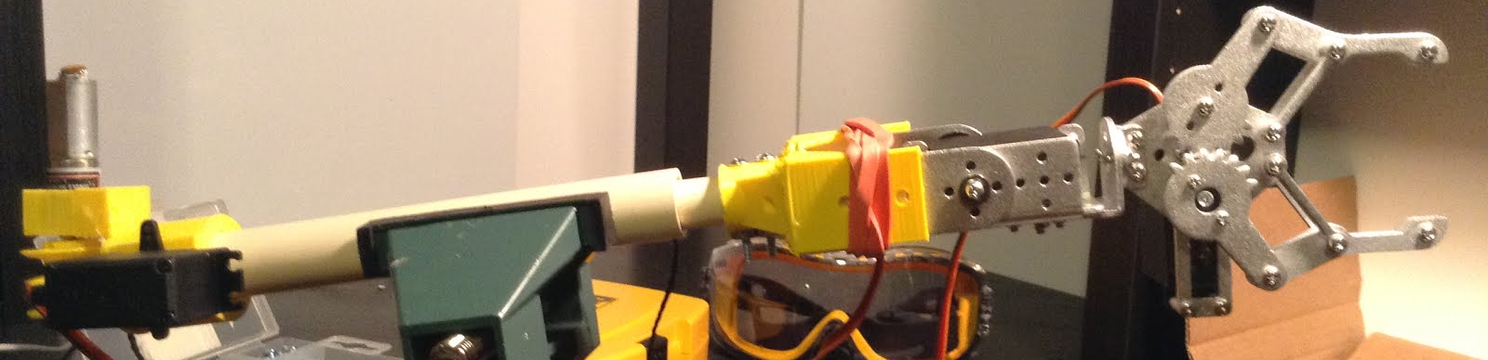
Independant Project
Robotic Arm
Conrad Tulig

Slide 2
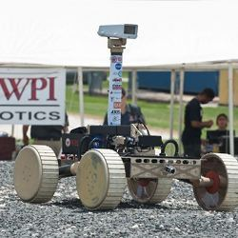
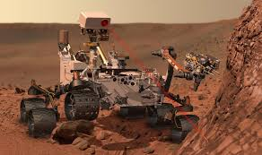
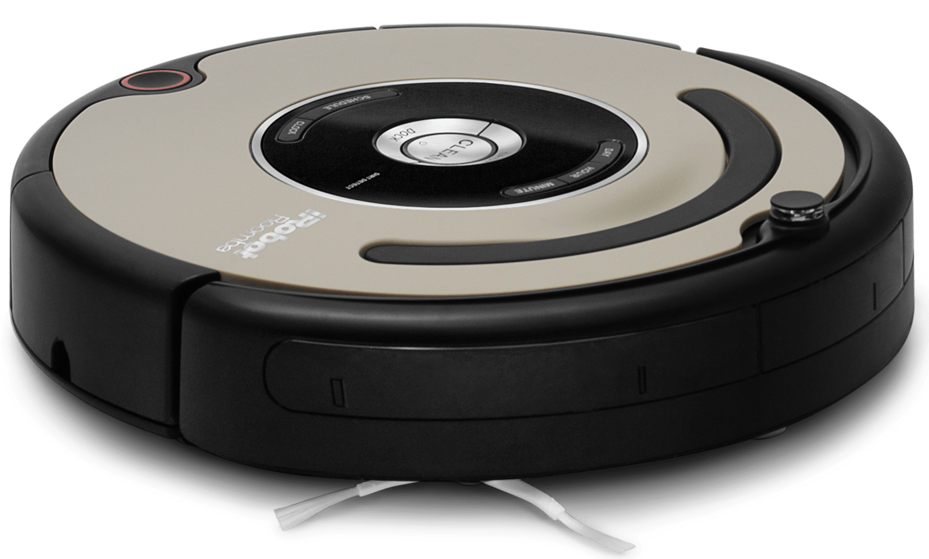
How I chose my project?
I knew I wanted to do a project using a robotic arm. -Mars rover based. Influenced by WPI robotics competition. Pick up samples and bring them back to home base.
-Cleaning robot. Influenced by Roomba. Pick up toys and clothes off the ground and put them away in assignment locations.

Slide 3




Goals
My main objective is to program an object recognition camera that works with a created robotic arm for it.
-My initial learning goals involved learning how to use 3D CAD software to 3D print the parts for this robotic arm. For programming, my goal was to expand my knowledge in C programming on an Arduino that I had planned to use for the project.
-However, after conducting more research on object recognition cameras, I realized and Arduino would not be powerful enough for my needs, and therefore have moved on to a goal of learning to use and program on a Raspberry pi 2.

Slide 4
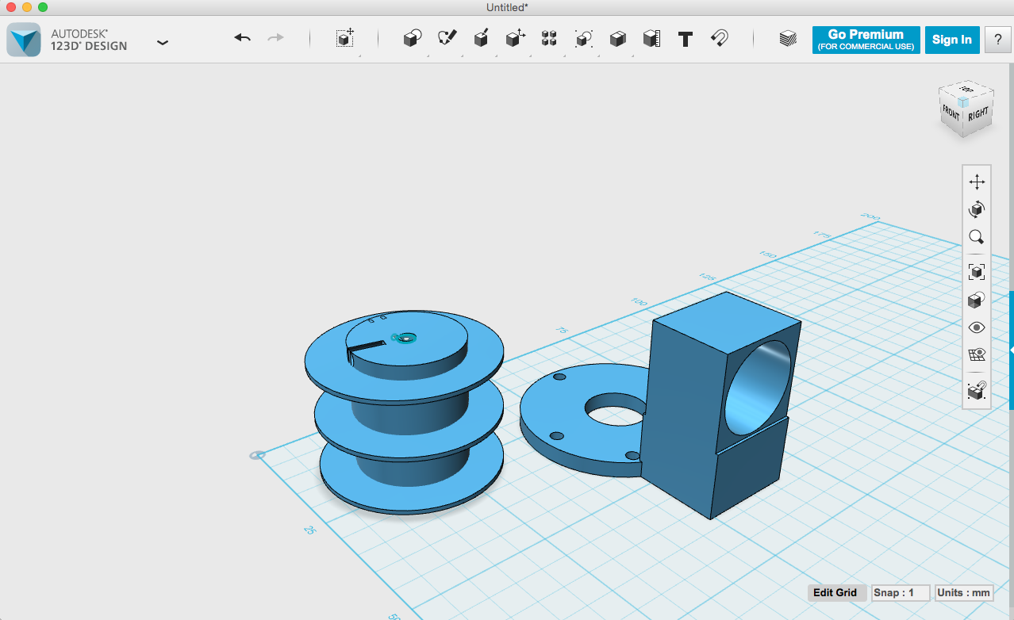
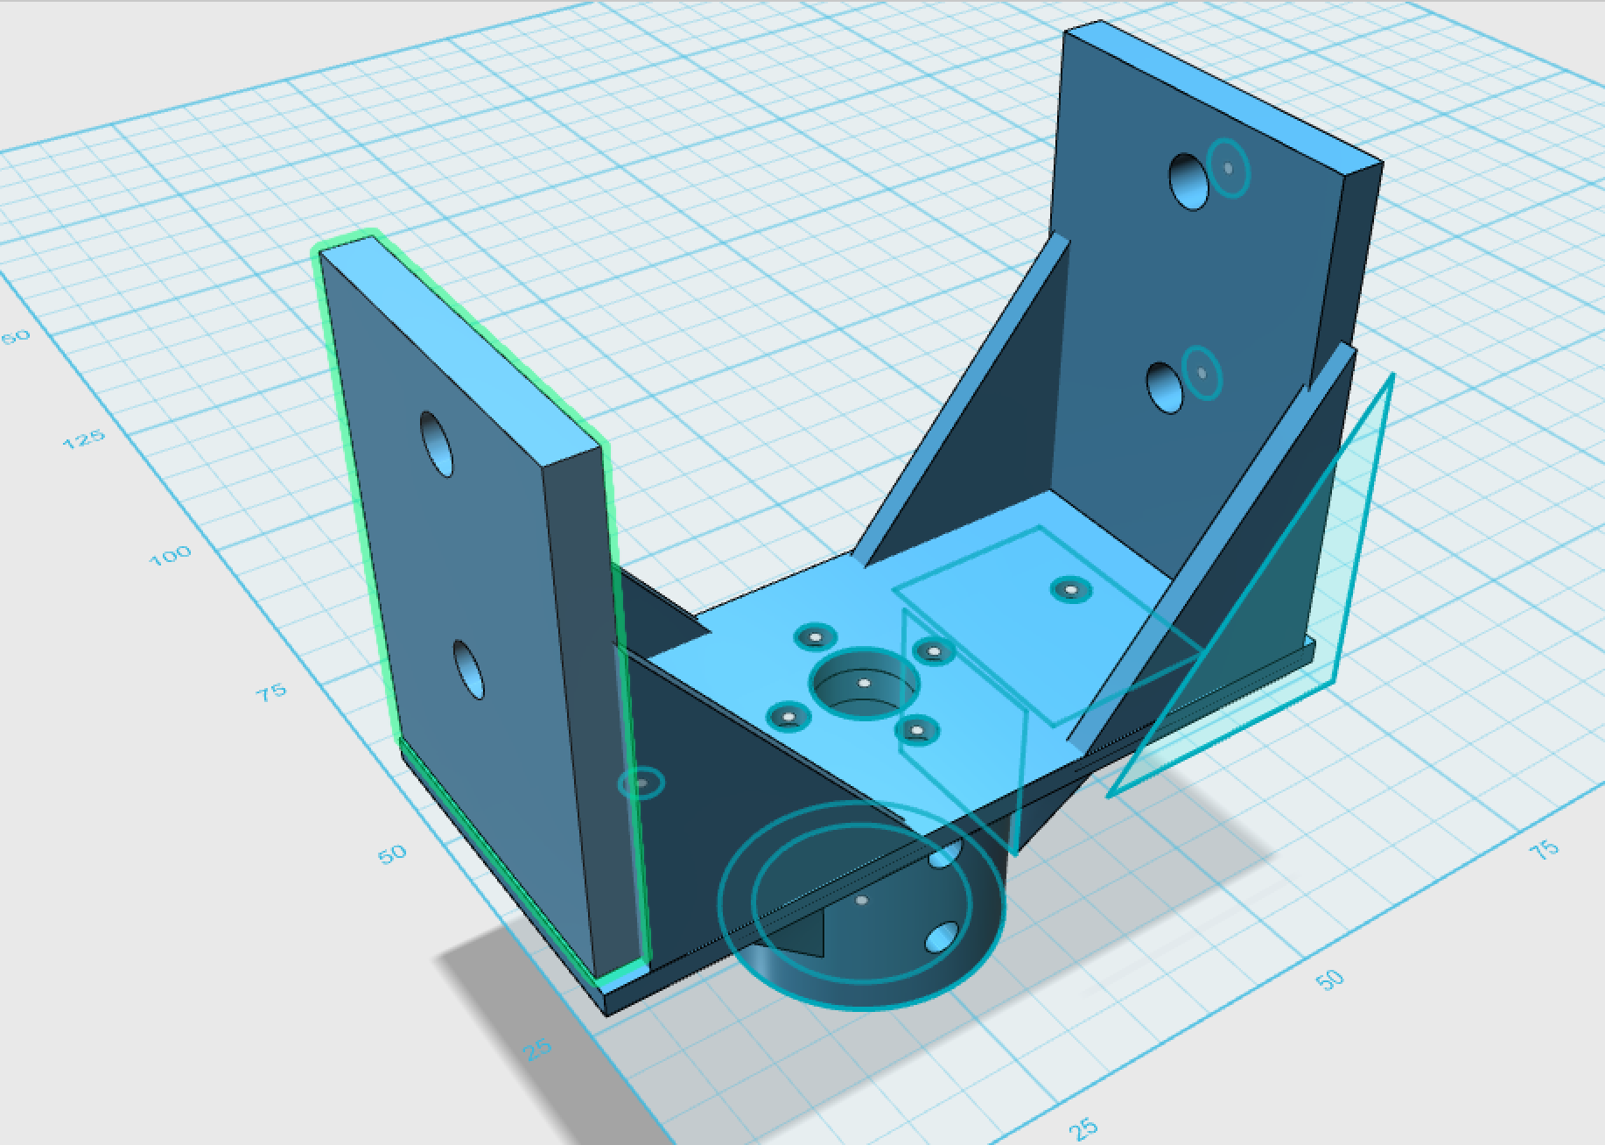
3D Designing the Arm
The simple different commands of creating 2D shapes, press/pulling sides further in or out, and creating lofts between sides can be used to build the complex shapes of my robot.
-I used the free cad software, 123D Design, to design the parts for my arm.
-I learned throughout my designing of my parts that I had to be exact down to the millimeter in order to make everything fit together smoothly.

Slide 5
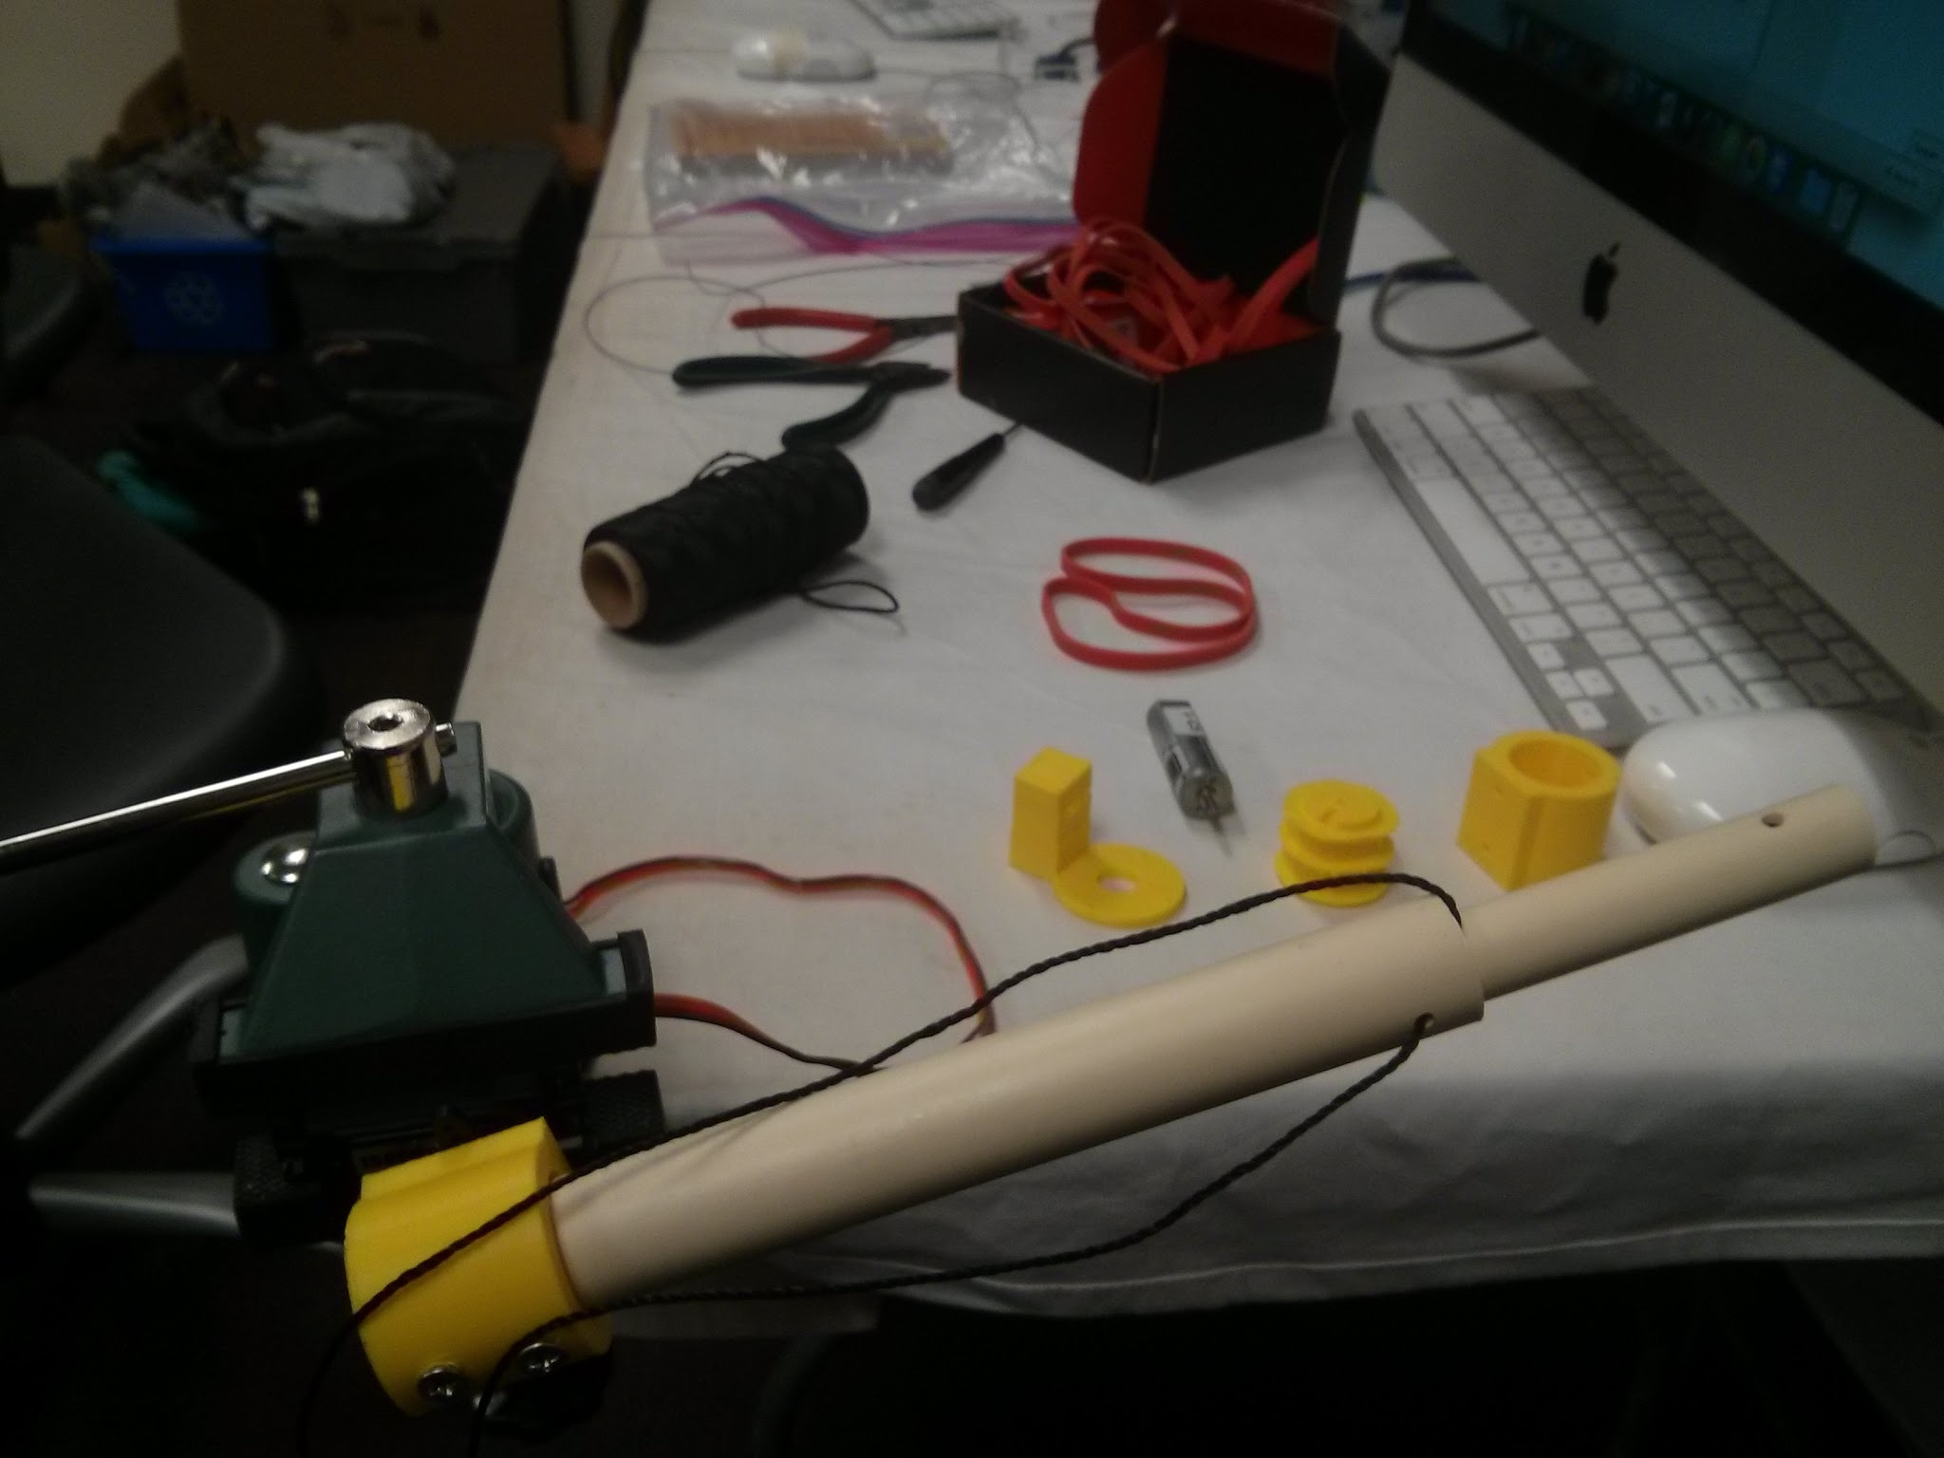
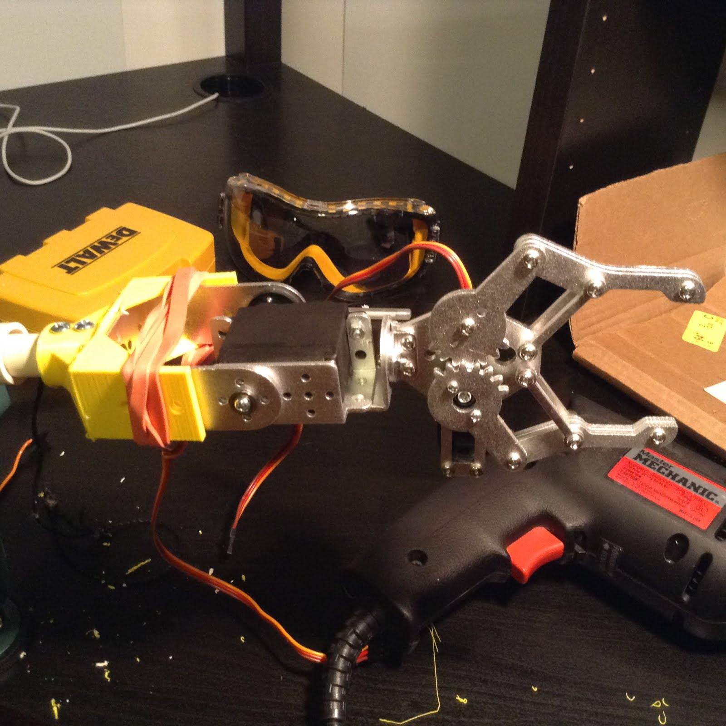
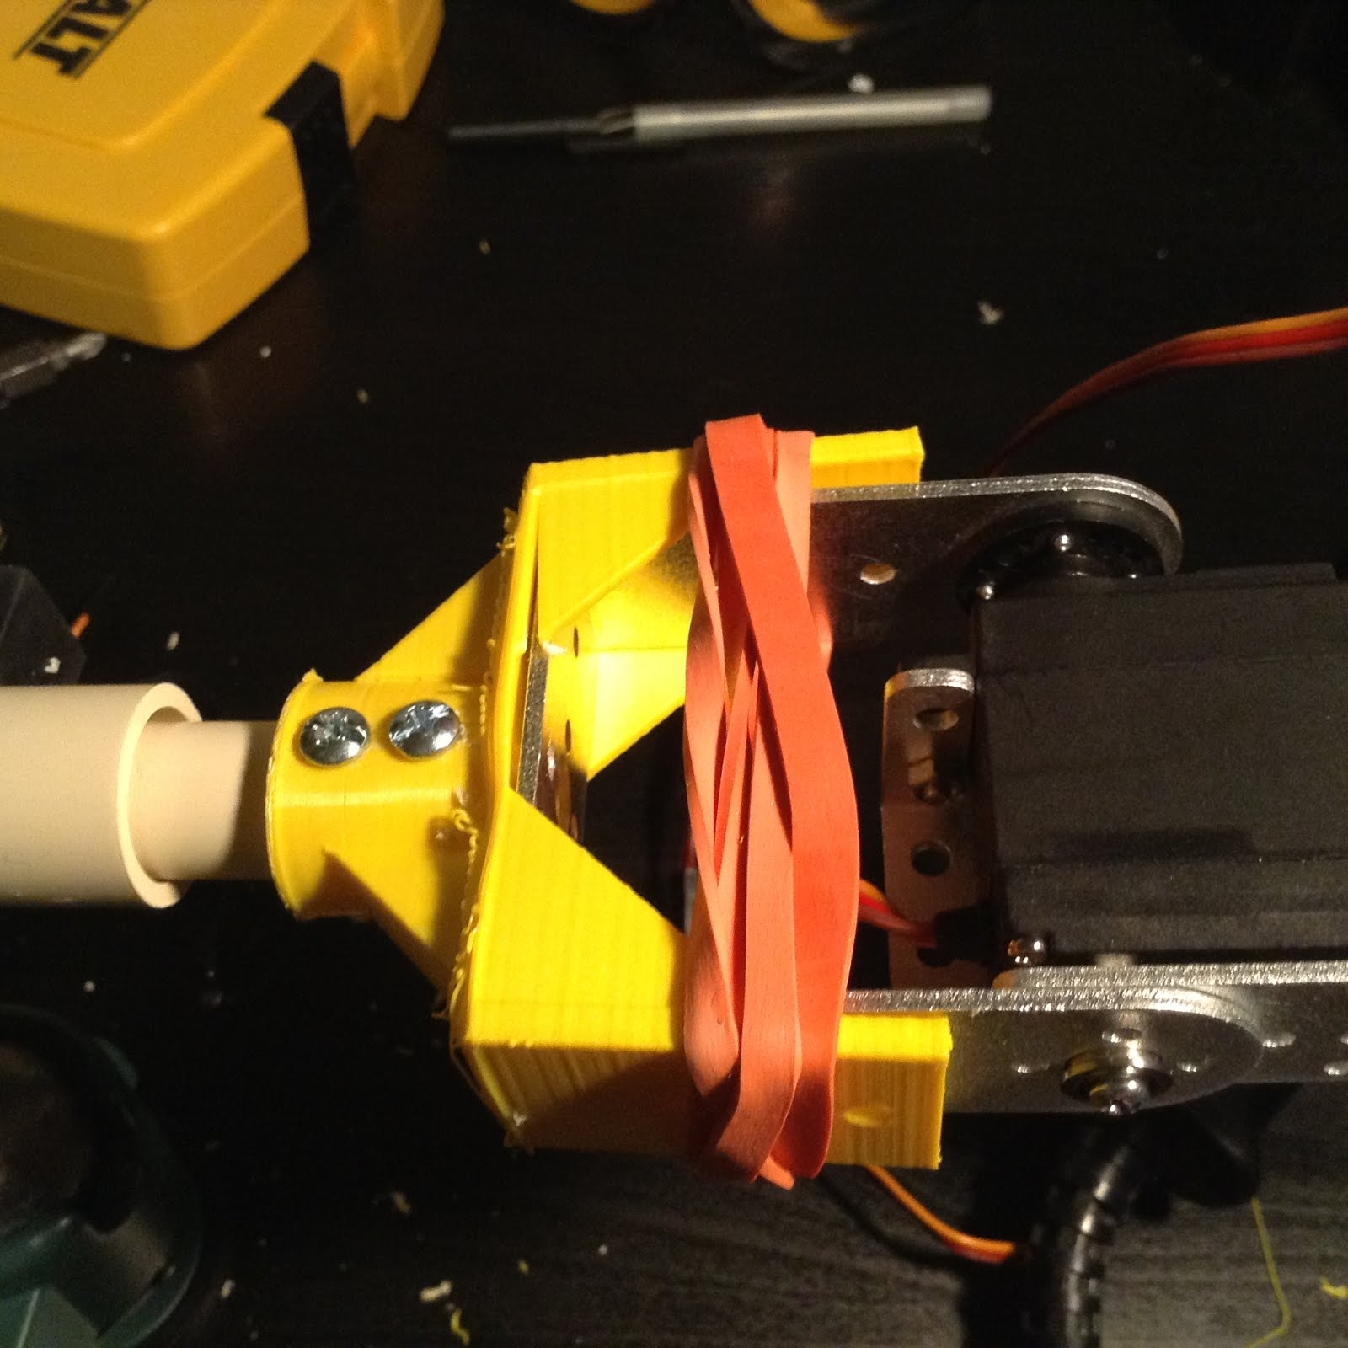
Mechanical Design
-Telescoping arm with 2 PVC pipes with a regular motor(64:1) to extend and retract the inner pipe with a spool system.
-Shoulder servo motor and wrist servo motor(Still haven’t decided on a horizontal or vertical rotation) for more maneuverability
-Two pronged claw with a servo motor, 5.5 cm opening. I will be adding a heat shrink rubber tube on the prongs from better grip.

Slide 6
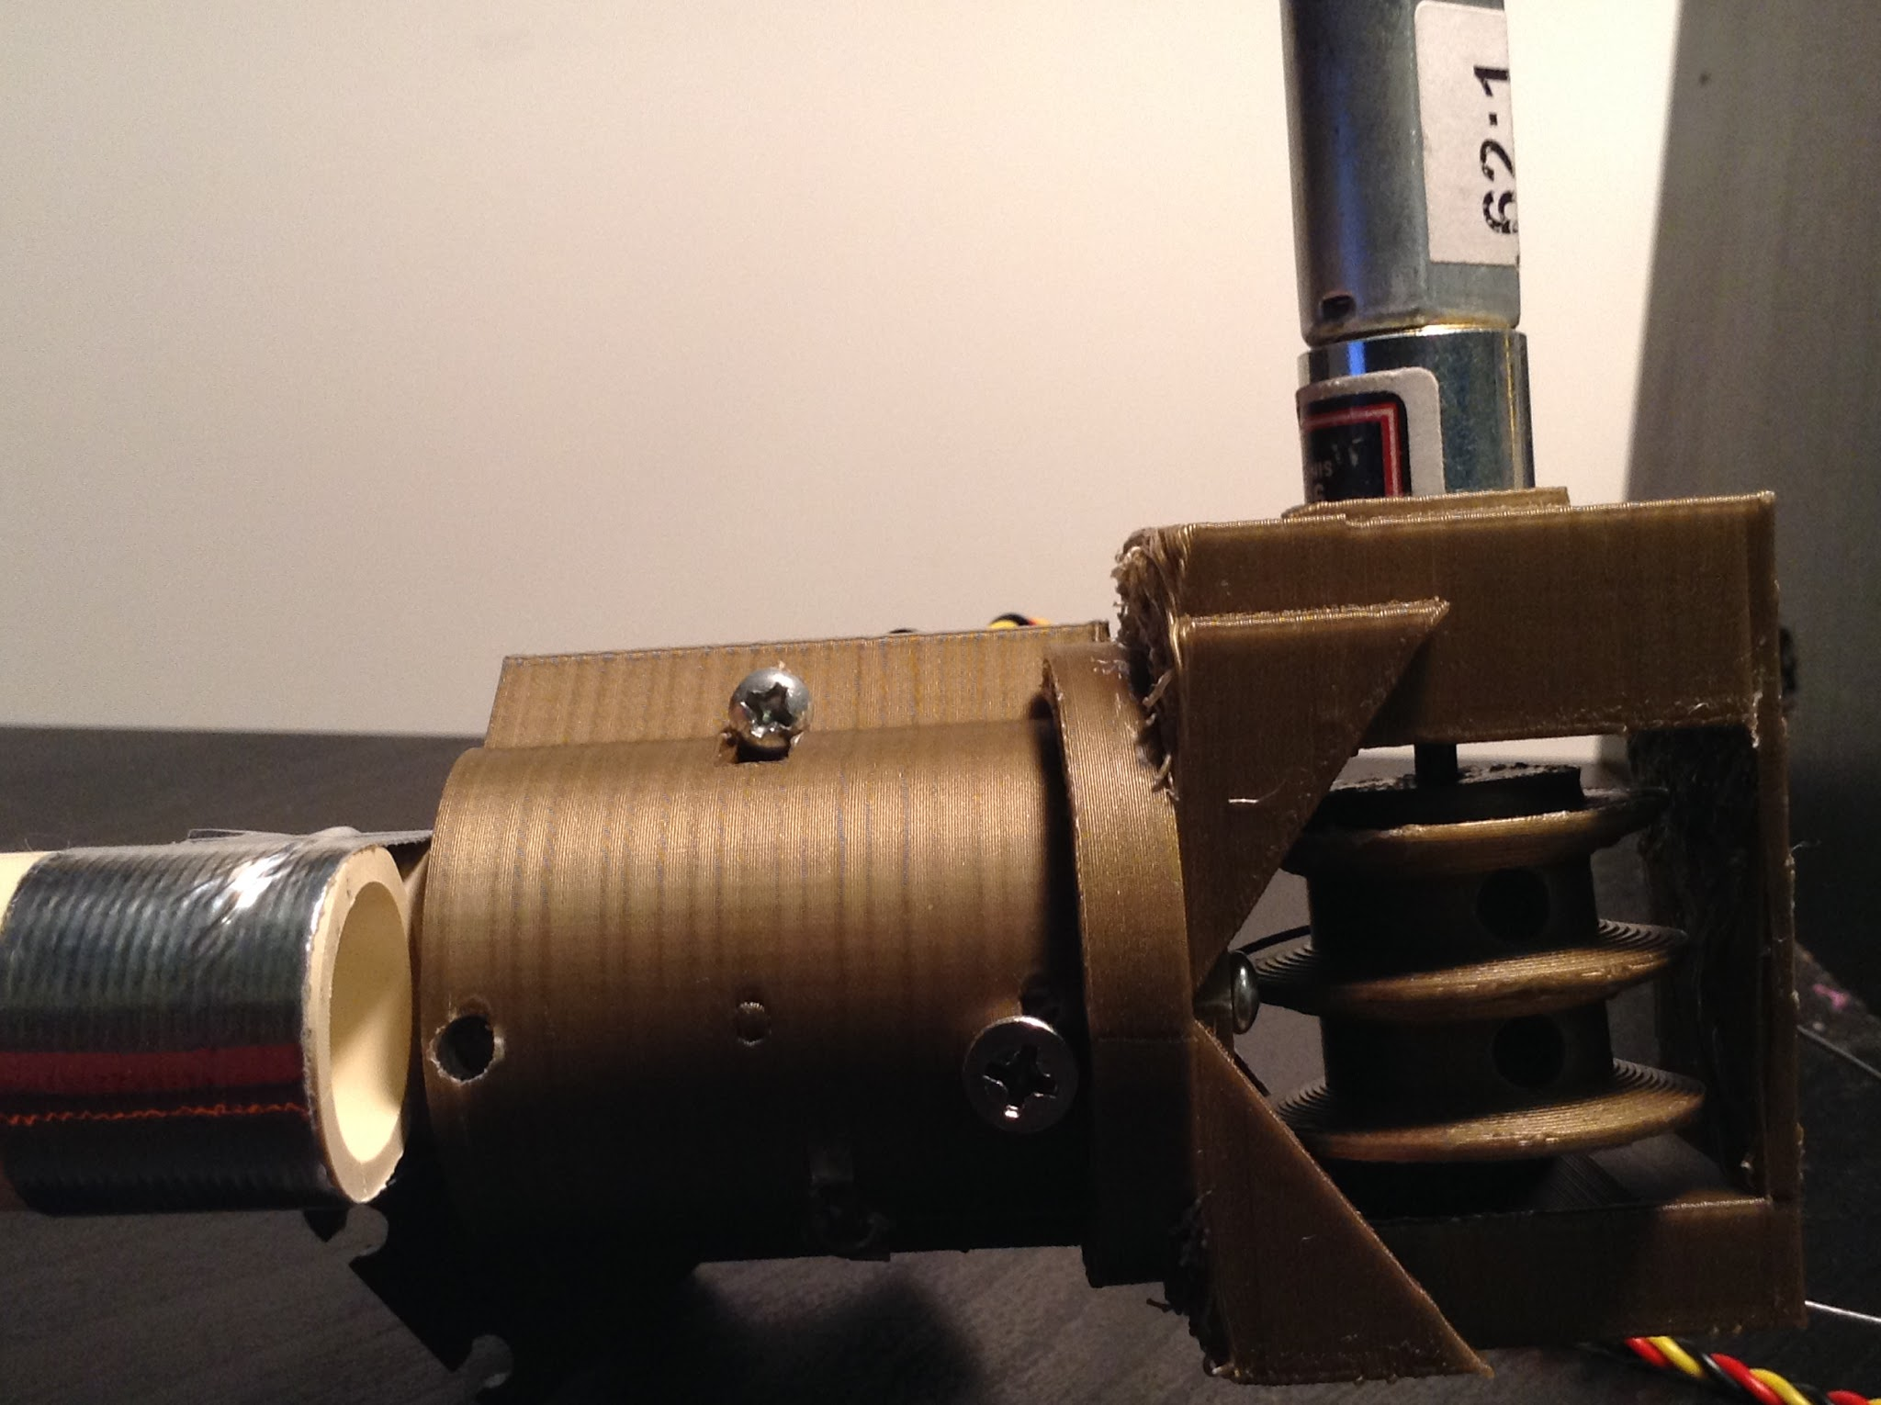
Close Up Pictures and Diagrams of the Arm.
Telescoping Arm
.03kg; .3 N
Servo motor rotates arm up and down.

Slide 7
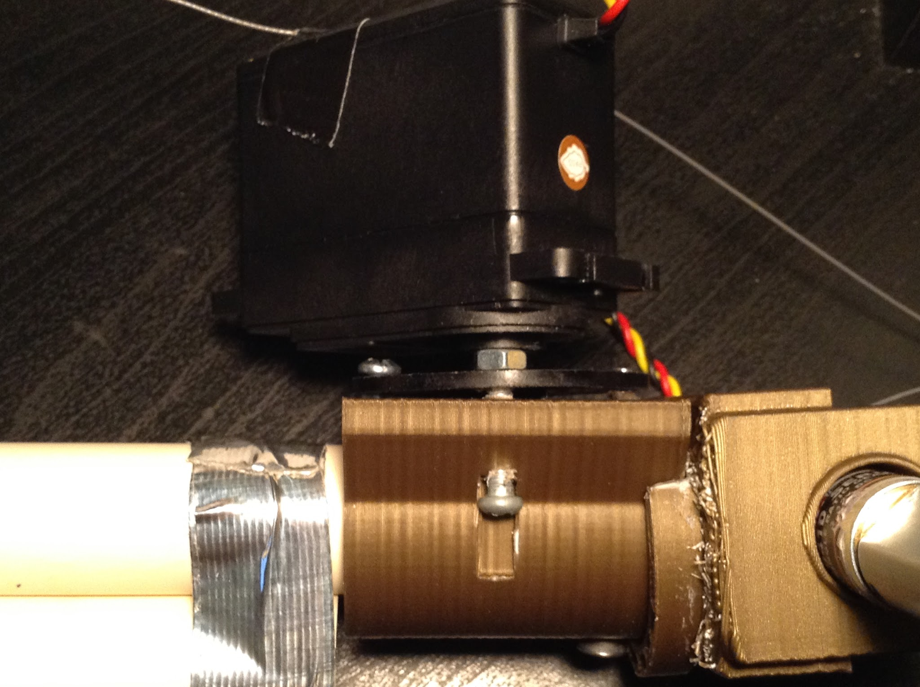
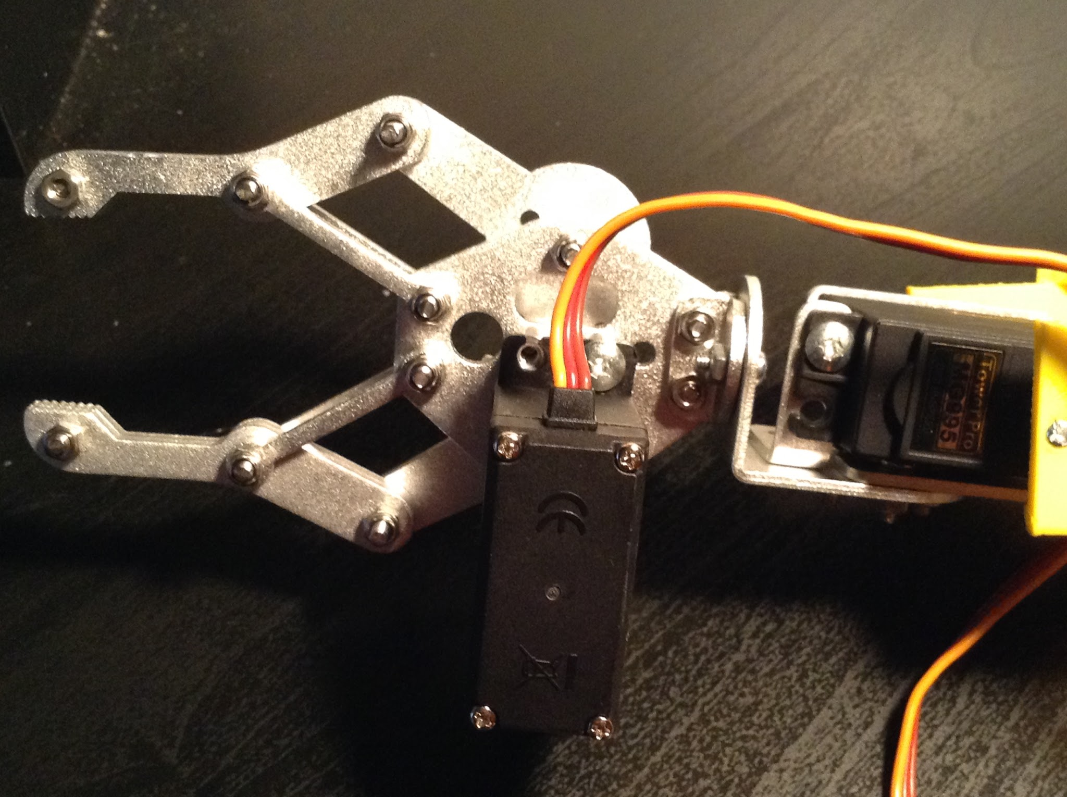
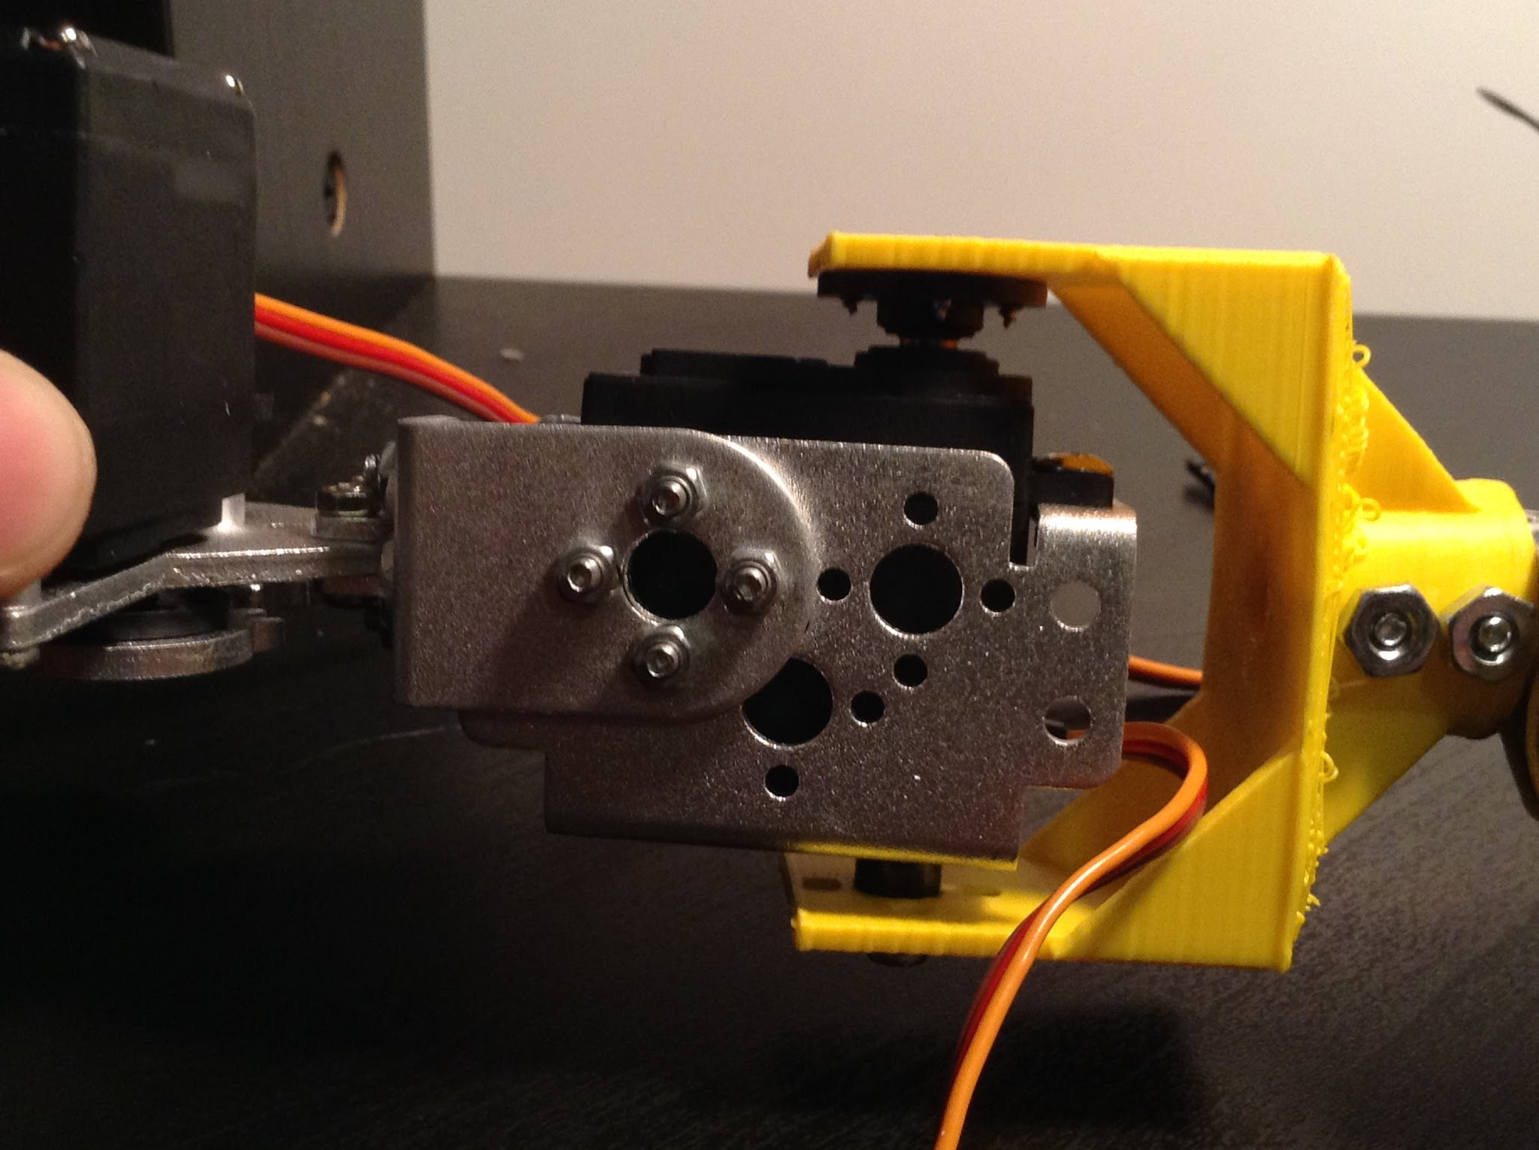
Close Up Pictures and Diagrams of the Arm.

Slide 8
Videos of the Arm.
https://drive.google.com/open?id=0ByNervjWsNPXbHg2YUdnZWNkbk0 Wrist Motor.
https://drive.google.com/open?id=0ByNervjWsNPXb2RZWFhfYVV4NHM Hand Motor.

Slide 9
Software / Programming
-I have only recently begun the software/programming portion of my project, and most of this has just been research.
-Due to Arduinos being not powerful enough to compile object-reconition cameras I had to get a Raspberry Pi 2 to be able to run the camera.
-I plan to set up a Master to Slave system between the Pi and the Arduiono, where the Pi recieves the camera inputs as the brain, and relays commands to the Arduino, which uses those commands to excecute the hardware movements of the arm.

Slide 10
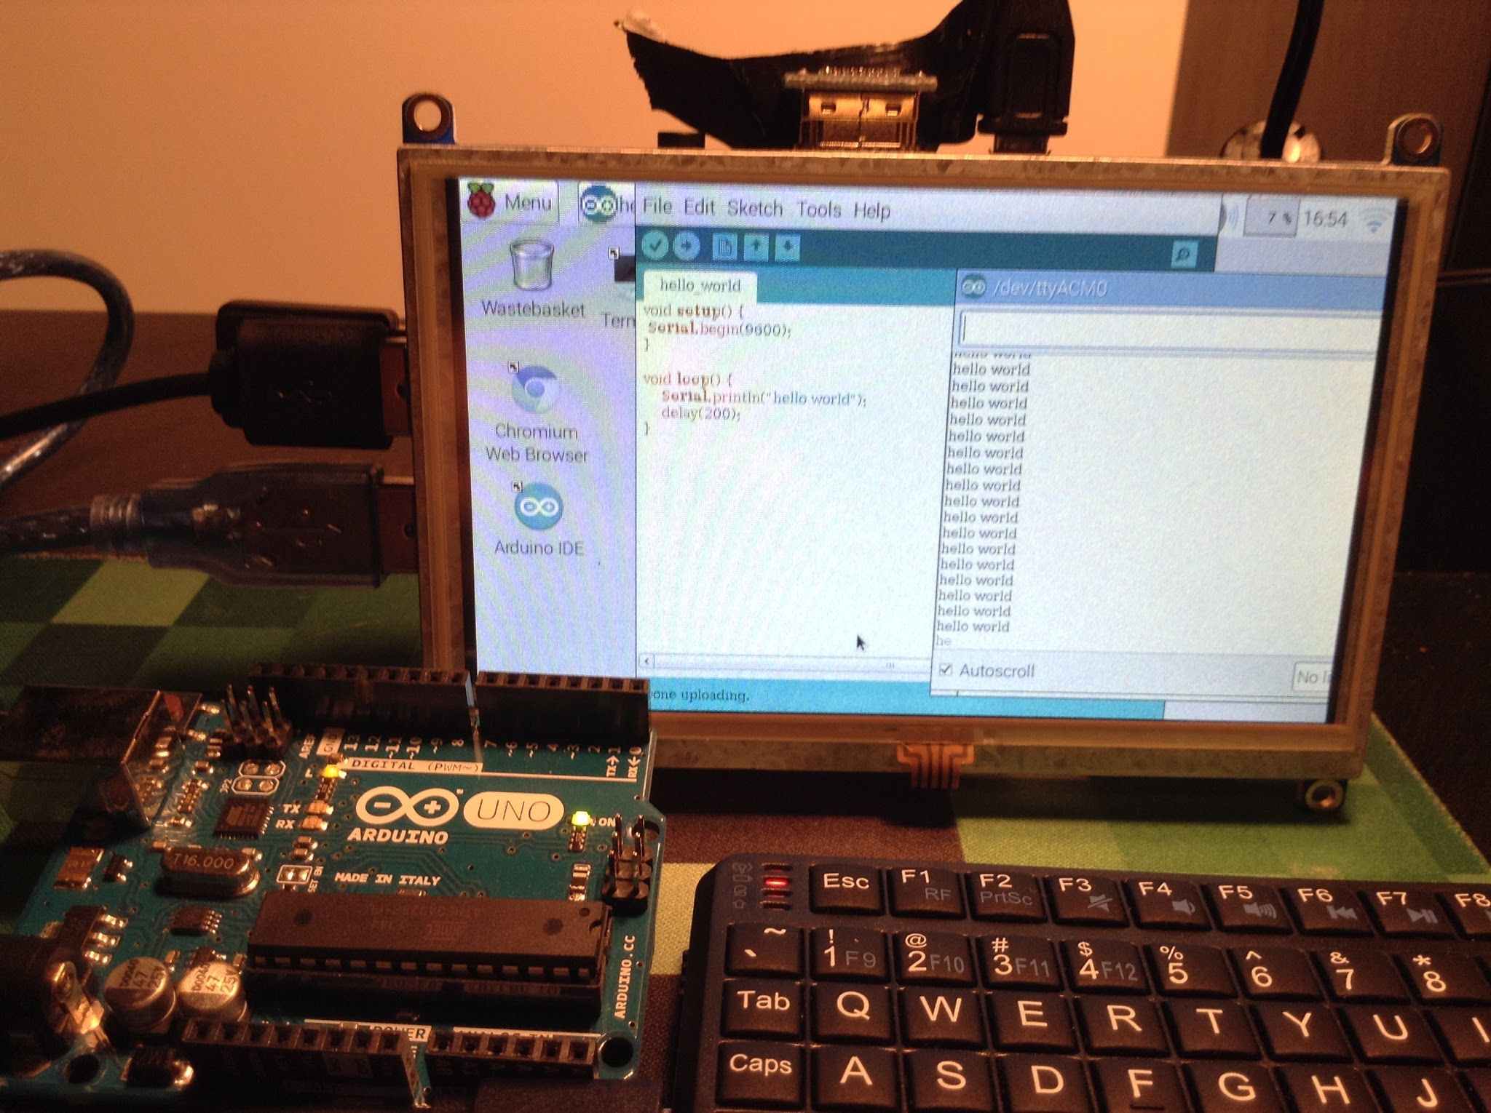
Raspberry Pi 2 and Arduino Setup

Slide 11
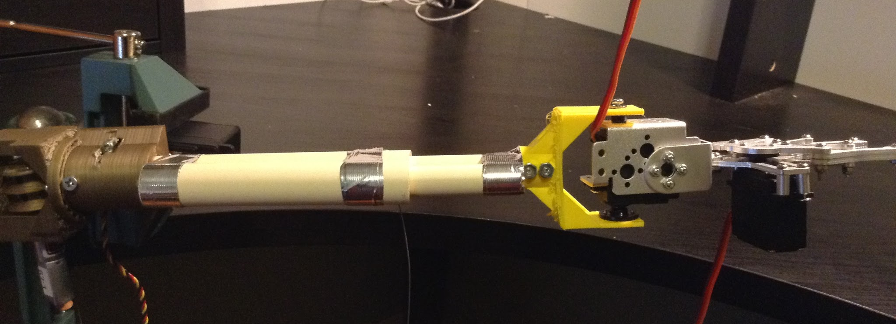
Final Update of the Arm:

